Slide 1
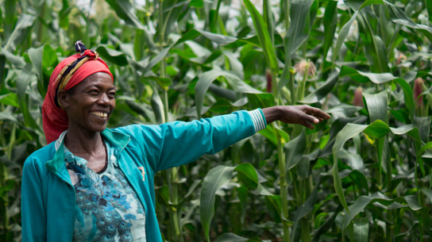
Harvest Service
“What is impossible for people is possible with God.”
Luke 18:27
Autumn 2020

Slide 2
Ethiopia

Slide 3
1. About ____% of the mountains in Africa are located in Ethiopia.
70% or
b. 40%?

Slide 4
Answer:
a. 70%

Slide 5
2. Ethiopia is the fifth largest producer of what product?
a. Salt or
b. Coffee?

Slide 6
Answer:
b. Coffee

Slide 7
3. How many UNESCO World Heritage sites are in Ethiopia?
a. Nine or
b. Seven?

Slide 8
Answer:
b. Nine

Slide 9
4. ___% of Ethiopians have no reliable source of water or soap.
a. 51% or
b. 64%?

Slide 10
Answer
a. 51%

Slide 11
5. In 2000, life expectancy in Ethiopia was 50 years. Now it is ___ years.
a.70 or
b. 65?

Slide 12
Answer
b. 65 years

Slide 13
Greetings from Ethiopia
Genet with her family – courtesy Genet Beyene

Slide 14
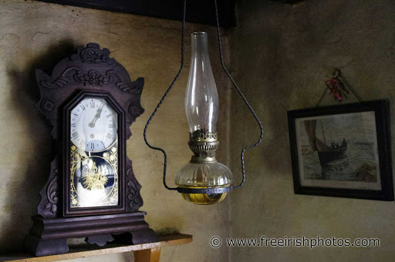
Living without electricity in Ireland

Slide 15
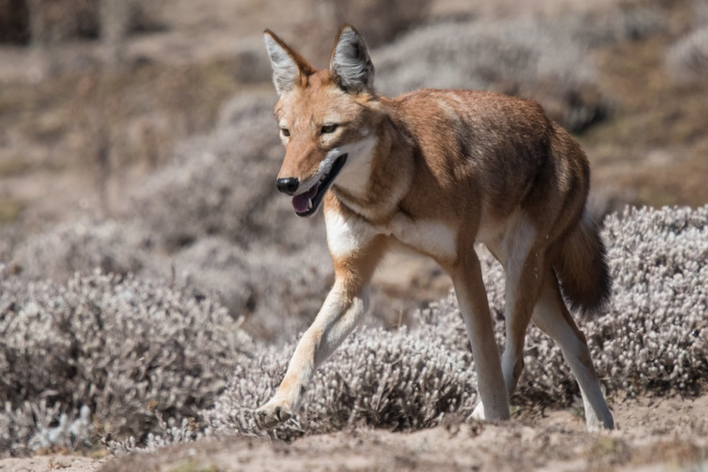
Ethiopian Black Maned Lion and the Ethiopian Wolf

Slide 16
Amarech and Mattheos

Slide 17
‘Many of my friends considered me a crazy woman!’
Amarech working in her field

Slide 18
The Harvest

Slide 19
The difference in the Harvest

Slide 20
Now Amarech and Mattheos work together

Slide 21
‘I never thought that something so simple could change my live forever but with God anything is possible.’ Amarech

Slide 22
Amarech’s Favourite Bible Verse
‘I lift up my eyes to the hills. From where does my help come? My help comes from the Lord, who made heaven and earth.’
Psalm 121:1-2

